Slide 1
Capstone Project
Presented By Group - eShield
Rajiv, Chintan & Hardik

Slide 2
Introduction
This study is a part of Capstone Project for EPABA Batch 05 and it explores the factors influencing cyber security during online transactions related to digital payments, e-Services and related safety perceptions among consumers. By analyzing these factors, we can gain insights into patterns of adoption of digital payments and e-services, its associations with demographic variables and challenges for adoption of digital payments and other e-services.
Project Team
Chintal Joshi | Questionnaire Framing, Data Collection, Data Pre-Processing, Noise Reduction, Report Writing
Rajiv Trivedi | Data Collection Strategies, Exploratory Analysis, Logistic Regression, Predictive Analysis, Report Writing
Hardik Raval | Linear Regression, Inference, Report Writing

Slide 3
Method
Define research Questions
Data Collection (Ahmedabad Geography)
Data Normalization
Exploratory Analysis
Predictive Analysis
Conclusion

Slide 4
Project Methodology
Design a survey to collect data on e-services usage during digital payments, online purchases, online learning platforms and demographic data of respondents such as sex, age, profession, etc.
Apply data pre-processing: normalize variables, remove noise, and ensure data integrity
Explanatory variables: sex, age, profession , type of e-services, extent of cyber security threat, frequency of transactions, merchant type
Response variables: using of online services (Yes/No), safety perception (Likert scale), Awareness about Fraud,
Analyze using simple linear regression: relate age, transaction data to digital payment adoption likelihood
Employ inferential statistics (chi-square tests, t-tests) for relationships between other variables
Regression analysis for demographic impact on adoption and safety perception

Slide 5
Data Collection
Data Collection Through Google Form ( Link is shared below)
https://forms.gle/eidJ1KNXuTGur3NB9
Sample Size : > 100
Geography: Ahmedabad
Age Group: Less than 60 Years
Target Sample : Students, Working Professionals, House makers

Slide 6
Project Time Plan
Data Collection : By 5th Nov
Review and Cleaning of Data: By 7th Nov
Data Analysis : By 10th Nov
1st Review : 7th Nov
2nd Review : 22nd Nov
3rd Review : 24th Nov
Final Report and Presentation : By 26th Nov

Slide 7
Define Questions for the Data
Check the Reponses by various factors
Age, Income, Occupation
Check how people are concerned about security on the Internet
Check how much people are aware about possibilities of fraud
Check the patten of who are likely to lose the money in fraud
Define Questions for the Data
Define Questions for the Data

Slide 8
Variables (selected)
Column | Variable
Timestamp | data_collectoin_timestamp
Email Address | email
Do you carry out online monetary transactions? | doing_transaction
Which electronic transaction method do you prefer the most? | transaction_method
Are you aware about cyber fraud in E-payments? | fraud_awareness
How much concerned are you about security on the Internet? | concerned
How often do you update your device’s operating system and applications? | os_update
Do you connect your device with public network? | public_network
Do you have prior knowledge about information security? | information_security_knowledge
Do you keep back-up of your data? | data_backup
If you are having back up of your data then how often do you take back-up of your data? | data_backup_scheule
Do you use any network security software technology to protect your device from attack? | network_security
Have you ever lost money during online transaction? | lost_money
Do you use two-factor authentication when possible? | two_factor
Will you perform online monetary transactions in future? | future_transaction
Name : | name
Contact Number: | contct
Email Address | email
Gender: | gender
Age | age
Education | education
Occupation | occupation
Annual Family Income(in rupees): | income_gropu

Slide 9
Data Normalization
Added dummy columns
Balancing Data : Upscaling with help of SMOTE
Fixed open text data
Removed incomplete data

Slide 10
Topics
Exploratory Data Analysis with help of Tableau
Predictive Analysis
Logistic Regression
Random Forest (concerned/not concerned)
Market Basket

Slide 11
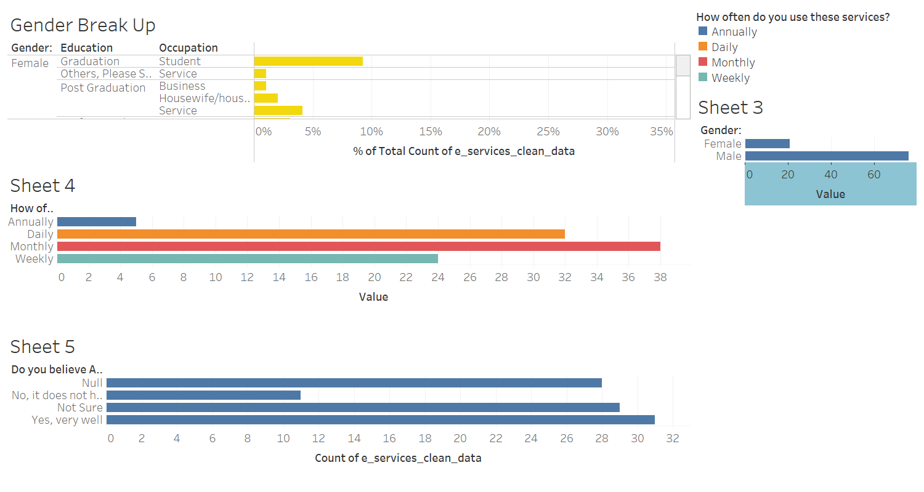
Data Exploration
Tableau Dashboard
Define Questions for the Data
Define Questions for the Data

Slide 12
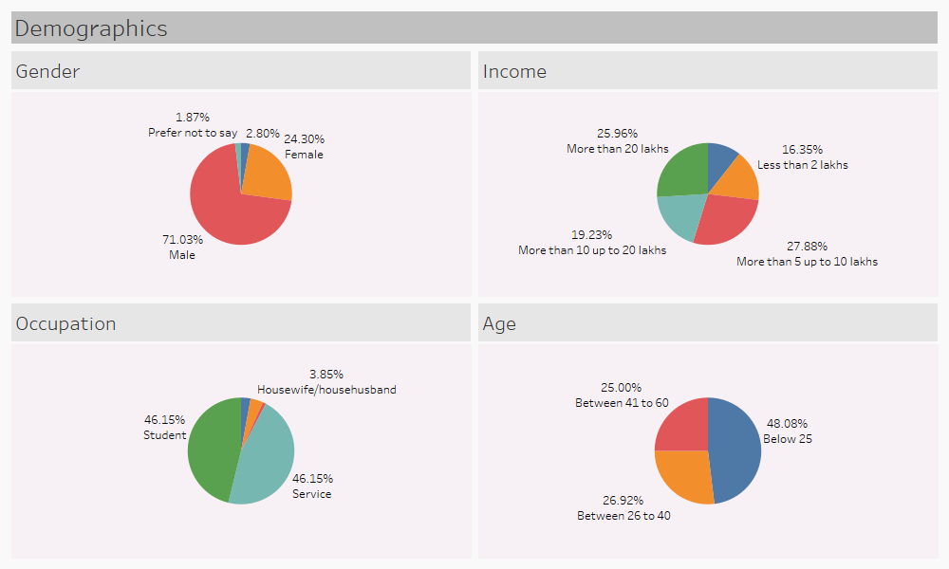
Data Exploration
Define Questions for the Data
Define Questions for the Data

Slide 13
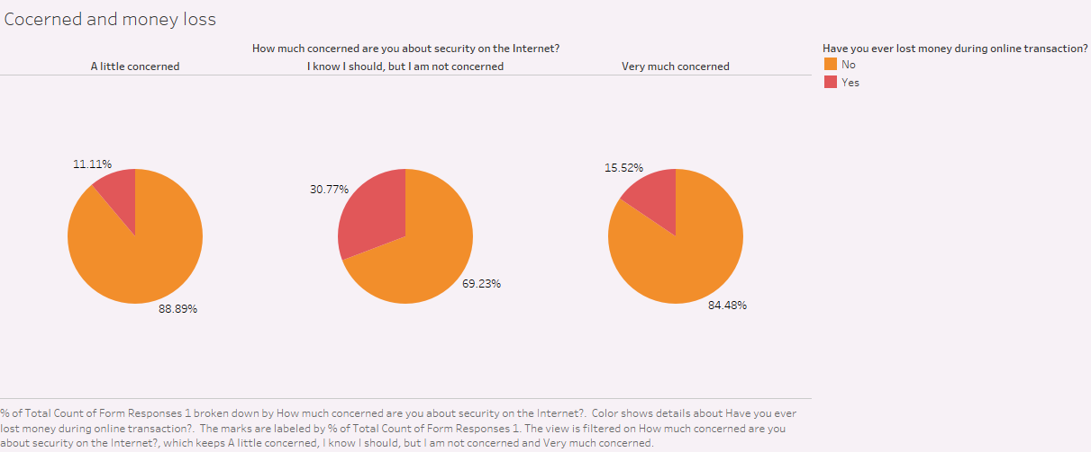
Data Exploration
Define Questions for the Data
Define Questions for the Data

Slide 14
Objective
Random Forest
To analyze the characteristics of individuals susceptible to falling victim to online transaction fraud.

Slide 15
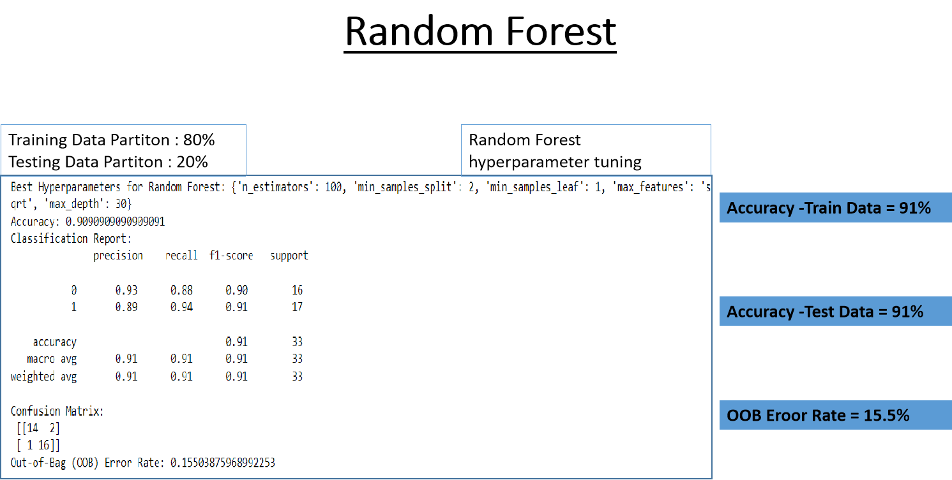
Random Forest

Slide 16
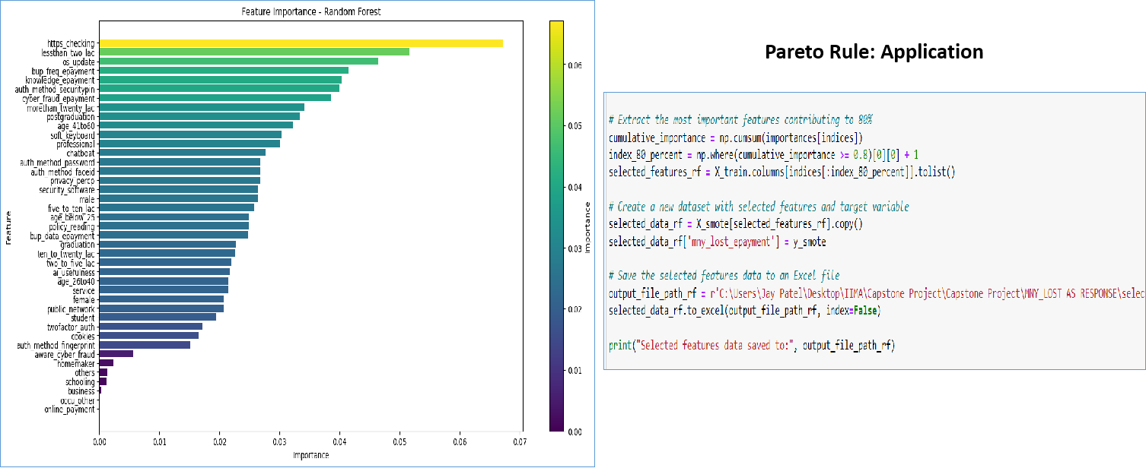
Random Forest
Important
Features
Pareto Rule
Application

Slide 17
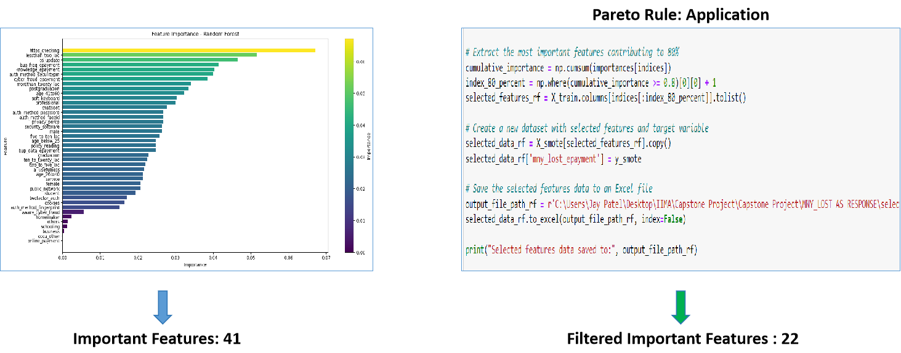
Important
Features
Pareto Rule
Application
Final Filtered
Features

Slide 18
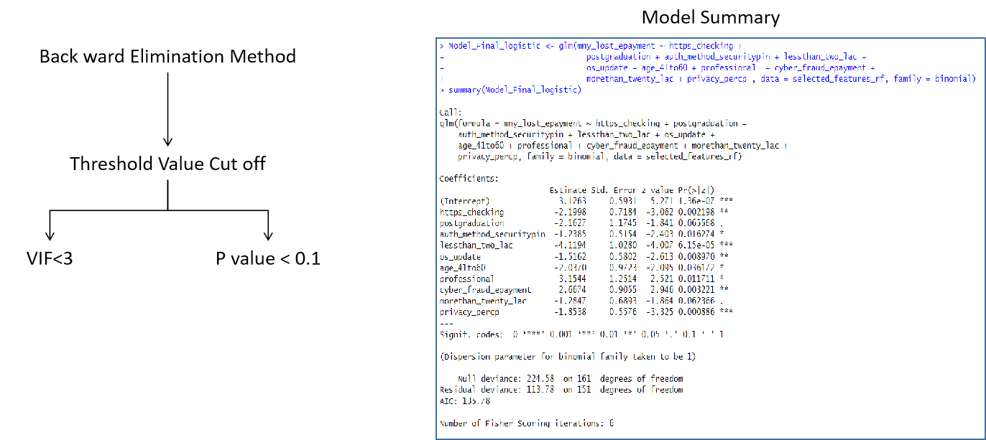
Logistic
Regression
Back ward
Elimination
Final Model
Summary

Slide 19
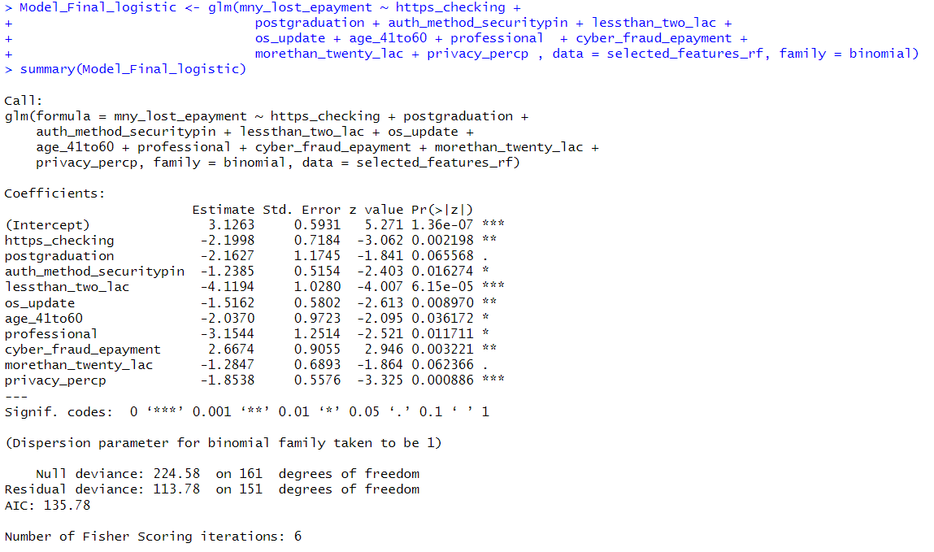
Logistic
Regression
Back ward
Elimination
Final Model
Summary
Significant Variables
10

Slide 20
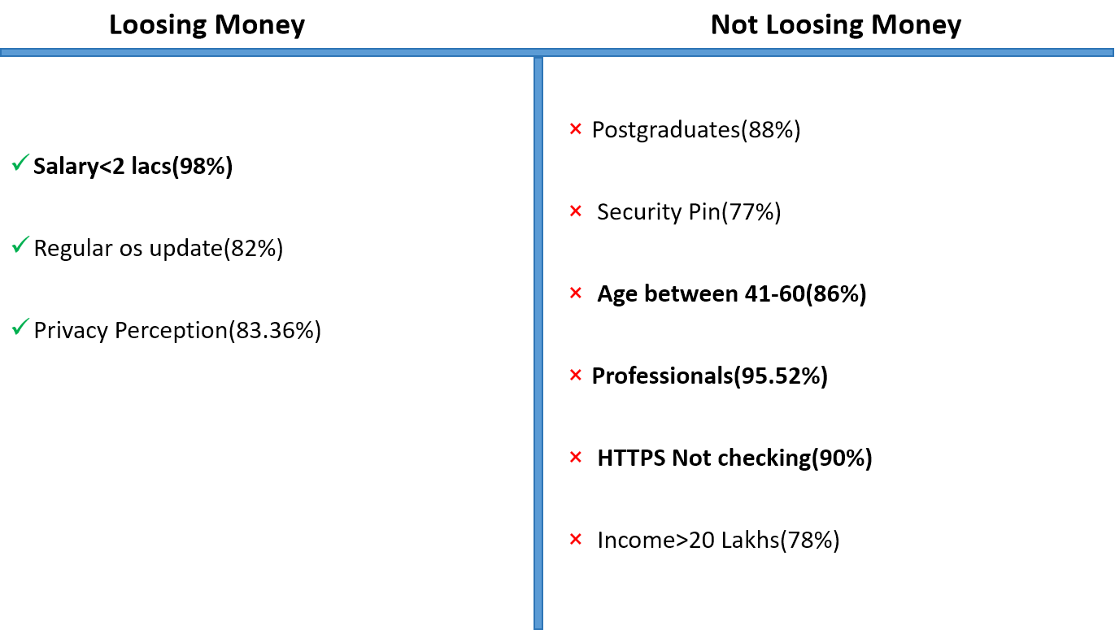
Conclusion

Slide 21
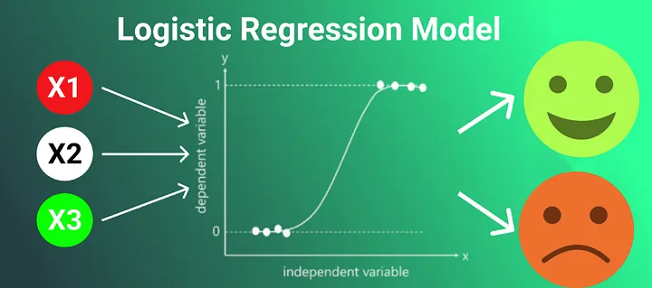
Predict how concerned are people about security on internet
Response Variable : Binary
1-> Very much concerned
2-> Not concerned
Explanatory Variable
Demographics (i.e Age, Gender, Profession, income)
Method
library loads
Read Data
Used one hot encoding (introducing dummy colums for categorical variables
Used SMOTE to upsize data
Run the Initial Model
first output
Remove singularities and variable based on p-value and vifs
Prediction
ROC Curve and find optimum threshold and optimum prediction-
Choose threshold with max sensitivity code
Define Questions for the Data
Define Questions for the Data

Slide 22
Predict how concerned are people about security on internet
Initial Model
logistic_model <- glm(concern_binary ~ is_male + is_female + age_group + is_graduate + is_postgraduate + is_schooling + is_other_education + is_business + is_service + is_student + is_homemaker + income_group, family = binomial, data = data)
Final Model
final_model <- glm(concern_binary ~ age_group + is_student, family = binomial, data = data)
Call:
glm(formula = concern_binary ~ age_group + is_student, family = binomial,
data = data)
Coefficients:
Estimate Std. Error z value Pr(>|z|)
(Intercept) 5.0151 1.6287 3.079 0.002076 **
age_group -1.7268 0.6137 -2.814 0.004897 **
is_student -3.5396 1.0728 -3.299 0.000969 ***
Define Questions for the Data
Outcome
With more than 60% accuracy found relationship of the probability of having people more concerned about security as below

Slide 23

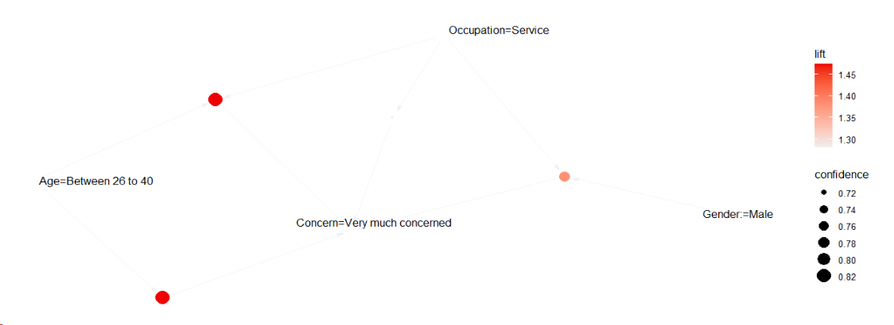
Predict how concerned are people about security on internet
Using Market Basket Analysis to find the rules that has right hand side as
Very much concerned
lhs | rhs | support | confidence | coverage | lift
{Age=Between 26 to 40} | => {Concern=Very much concerned} | 0.2211538 | 0.8214286 | 0.2692308 | 1.472906
{Occupation=Service} | => {Concern=Very much concerned} | 0.3365385 | 0.7142857 | 0.4711538 | 1.280788
{Age=Between 26 to 40, Occupation=Service} | => {Concern=Very much concerned} | 0.2211538 | 0.8214286 | 0.2692308 | 1.472906
{Gender:=Male, Occupation=Service} | => {Concern=Very much concerned} | 0.2884615 | 0.7692308 | 0.375 | 1.37931
Define Questions for the Data
Define Questions for the Data

Slide 24
Predict how are people not Fraud Aware
Using Market Basket Analysis to find the rules that has right hand side as
fraud_awareness=No
lhs | rhs | support | confidence | lift
------------------------------------------ | ----------------------- | -------------- | ------------ | -----
{information_security_knowledge=No, | {fraud_awareness=No} | 0.02884615 | 1 | 26
data_backup=No,
two_factor=No,
Gender:=Female}
------------------------------------------ | ----------------------- | -------------- | ------------ | -----
{public_network=Yes, sometimes, | {fraud_awareness=No} | 0.02884615 | 1 | 26
data_backup=No,
two_factor=No,
Gender:=Female}
------------------------------------------ | ----------------------- | -------------- | ------------ | -----
{transaction_method=UPI, | {fraud_awareness=No} | 0.02884615 | 1 | 26
data_backup=No,
two_factor=No,
Gender:=Female}
------------------------------------------ | ----------------------- | -------------- | ------------ | -----
{transaction_method=UPI, | {fraud_awareness=No} | 0.02884615 | 1 | 26
information_security_knowledge=No,
data_backup=No,
two_factor=No,
Gender:=Female}
------------------------------------------ | ----------------------- | -------------- | ------------ | -----
Define Questions for the Data
Define Questions for the Data

Slide 25
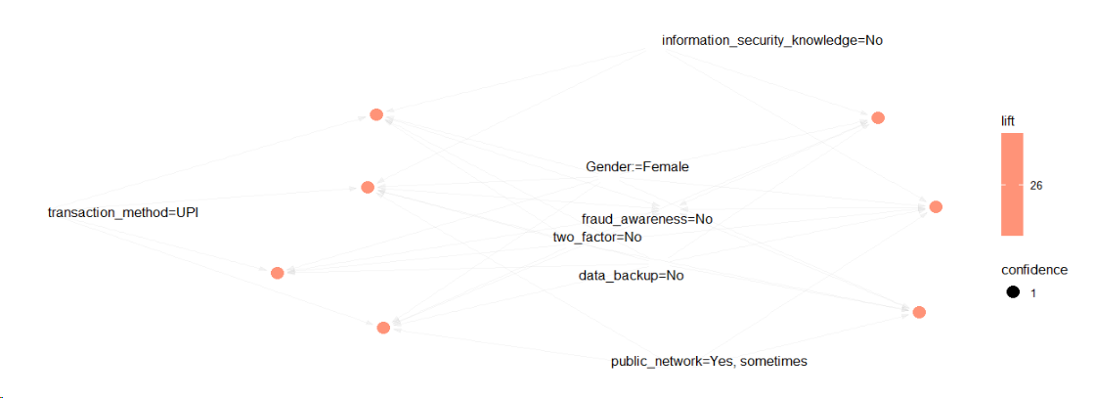
Predict how are people not Fraud Aware
Define Questions for the Data
Define Questions for the Data

Slide 26
Predict how are people not Fraud Aware
Used Market basket analysis Using Language R
information_security_knowledge=No
data_backup=No
two_factor=No
Gender:=Female
The rules suggest a strong association between the specified conditions in the lhs and the absence of fraud awareness (fraud_awareness=No).
Specifically, the rules indicate that when individuals have characteristics such as lack of information security knowledge, no data backup, no two-factor authentication, and are female, they are highly likely to not have fraud awareness.
The rules have high confidence, indicating a strong predictive power for the absence of fraud awareness given the specified conditions.
Define Questions for the Data
Define Questions for the Data

Slide 27
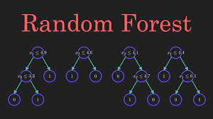
Predict how are people not Fraud Aware
Using Random Forest Method
fraud_awareness=No
Explanatory Varialbles
doing_transaction
transaction_method
concerned
os_update
public_network
information_security_knowledge
data_backup
data_backup_scheule
network_security
lost_money
two_factor
gender
Age
Education
Occupation
income
Define Questions for the Data
Define Questions for the Data
Tree 500
Number of variable 4 ~ SQRT(16)
Used smote to upsize data

Slide 28
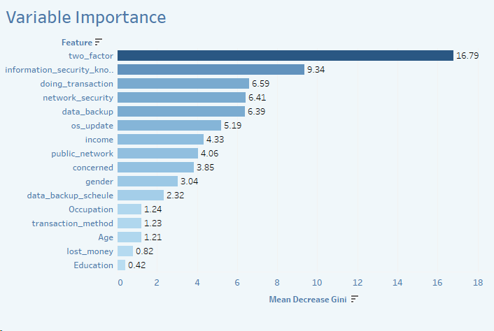
Predict how are people not Fraud Aware
Surprisingly We are getting 100% Accuracy to predict Fraud Awareness on train, testing, all data
Define Questions for the Data
Define Questions for the Data

Slide 29
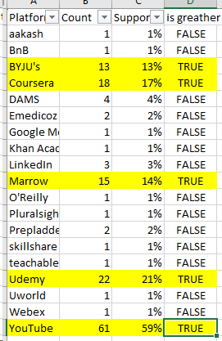
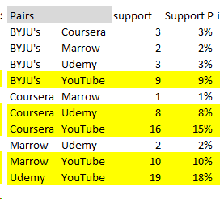
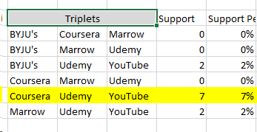
Study the usage pattern of online learning platform in combinations
Study the usage pattern of online learning platform in combinations
Minimum Support | 5%
Minimum Threshold | 75%
Define Questions for the Data
Define Questions for the Data

Slide 30
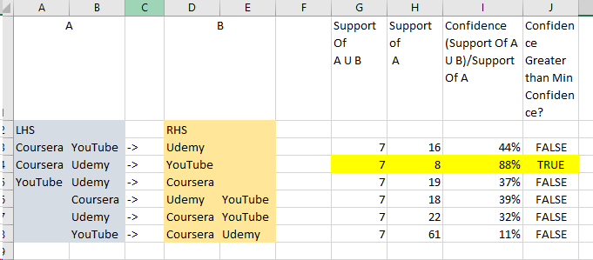
Study the usage pattern of online learning platform in combinations
Study the usage pattern of online learning platform in combinations
Minimum Support | 5%
Minimum Threshold | 75%
Define Questions for the Data
Define Questions for the Data
Conclusion with 88% confidence we can say people using coursera and udemy also uses youtube.

Slide 31
Thank You

